Slide 1

© 2002, Cisco Systems, Inc. All rights reserved.

Slide 2

Enabling EIGRP
© 2002, Cisco Systems, Inc. All rights reserved.
Notes:
Purpose: This chapter introduces the Cisco IOS™ CLI on the Catalyst® 1900 switch and router.
Timing: This chapter should take about 2 hours to present.
Note: The Catalyst 1900 switch only has a subset of the router Cisco IOS commands available.
Contents:
Introduction to Cisco IOS. Explain to the student what is IOS?
Cisco Device startup procedures in general.
IOS configuration source.
General introduction to the IOS CLI.
Cat 1900 switch startup procedures.
Intro to Cat 1900 CLI. This part covers the basic configuration on the switch, like setting the IP address and hostname. More details about the various Cat 1900 switch configuration commands are explained in Chapter 6 and 7.
Router startup procedures. More details on the router startup process is discussed in chapter 5.
Router IOS CLI.

Slide 3
Objectives
Upon completing this lesson, you will be able to:
  Describe the features and operation of EIGRP
  Use Cisco IOS commands to configure dynamic routing using EIGRP, given a functioning router
  Use show and debug commands to identify anomalies in dynamic routing operation using EIGRP, given an operational router
Notes:
Slide 1 of 2
Purpose: This slide states the chapter objectives.
Emphasize: Read or state each objective so that each student has a clear understanding of the chapter objectives.
Note: Catalyst switches have different CLIs. The Catalyst 2900xl and the Catalyst 1900 has a Cisco IOS CLI. The Cisco IOS CLI commands available on the 2900xl is different from the 1900. The Catalyst 5000 family has no Cisco IOS CLI, and use the set commands instead. This class only covers the configuration on the Catalyst 1900 switch.

Slide 4
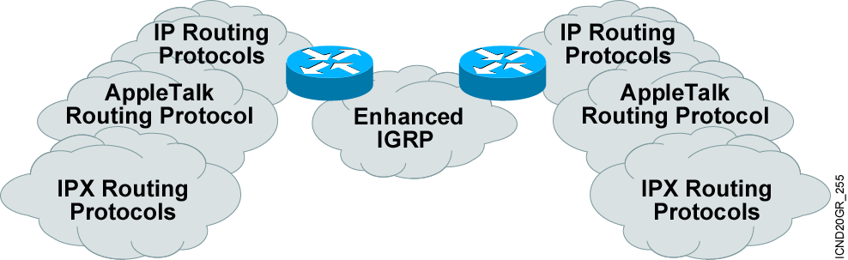
Introducing EIGRP
EIGRP supports:
  Rapid convergence
  Reduced bandwidth usage
  Multiple network-layer protocols
Notes:
Purpose: The figure introduces the IGRP routing protocol. IGRP is a sophisticated distance vector routing protocol.
Emphasize: The Interior Gateway Routing Protocol (IGRP) is a dynamic distance-vector routing protocol designed by Cisco in the mid-1980s for routing in an autonomous system that contains large, arbitrarily complex networks with diverse bandwidth and delay characteristics. Historically, IGRP became one of the success factors for the early Cisco IOS software capabilities because of its superiority to RIP version 1.
The important IGRP characteristics are as follows:
More scalability than RIP
Fast response to network changes
Sophisticated metric
Multiple-path support

Slide 5
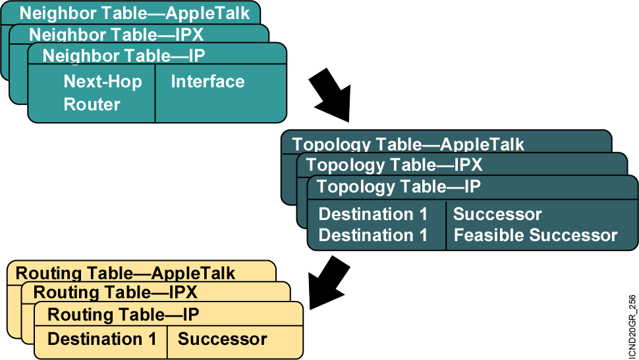
EIGRP Terminology

Slide 6
Comparing EIGRP and IGRP
  Similar metric
  Same load balancing
  Improved convergence time
  Reduced network overhead

Slide 7
Configuring EIGRP
Router(config)#router eigrp autonomous-system
Defines EIGRP as the IP routing protocol
Router(config-router)#network network-number
Selects participating attached networks
Notes:
Slide 1 of 2
Purpose: This figure explains how to use the router igrp and network commands to configure an IGRP process.
Emphasize: Note that the AS keyword is required for IGRP.
You can use multiple network commands to specify all networks that are to participate in the IGRP process. Only those networks specified will be published to other routers.

Slide 8
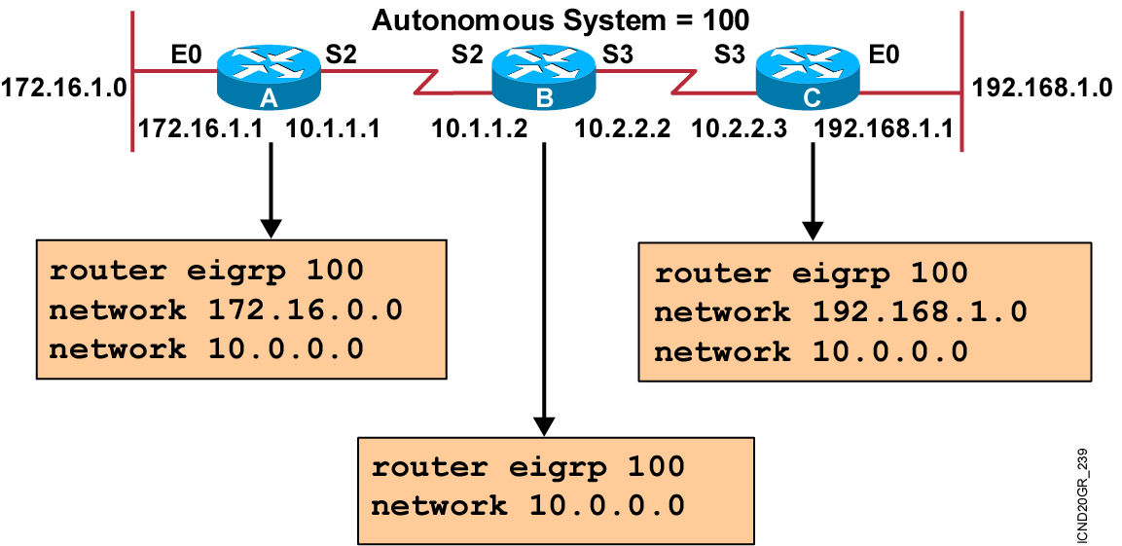
EIGRP Configuration Example
Notes:
Purpose: The figure shows how the IGRP commands operate on the example network.
Emphasize: An administrator only specifies directly connected networks that should be published to other routers.
Without the network command, nothing is advertised. With a network command, the router will advertise every subnet within the Class A, B, or C network specified in the configuration.

Slide 9
Verifying the EIGRP Configuration
Router#show ip eigrp neighbors
  Displays the neighbors discovered by IP EIGRP
Router#show ip eigrp topology
  Displays the IP EIGRP topology table
Router#show ip route eigrp
  Displays current EIGRP entries in the routing table
Router#show ip protocols
  Displays the parameters and current state of the active
  routing protocol process
Router#show ip eigrp traffic
  Displays the number of IP EIGRP packets sent and received
Notes:
Purpose: This figure shows how the show ip protocol command is used to monitor IGRP operation.
Emphasize: The command displays the routing protocols that are active on the router for IP. It also gives network and timer information. In this example, IGRP is displayed.
Point out the timing information.
Point out the list of networks for which the router is injecting routes.
Point out the administrative distance metric.

Slide 10
debug ip eigrp Command
Router#debug ip eigrp
IP-EIGRP: Processing incoming UPDATE packet
IP-EIGRP: Ext 192.168.3.0 255.255.255.0 M 386560 - 256000 130560 SM 360960 - 256000 104960
IP-EIGRP: Ext 192.168.0.0 255.255.255.0 M 386560 - 256000 130560 SM 360960 - 256000 104960
IP-EIGRP: Ext 192.168.3.0 255.255.255.0 M 386560 - 256000 130560 SM 360960 - 256000 104960
IP-EIGRP: 172.69.43.0 255.255.255.0, - do advertise out Ethernet0/1
IP-EIGRP: Ext 172.69.43.0 255.255.255.0 metric 371200 - 256000 115200
IP-EIGRP: 192.135.246.0 255.255.255.0, - do advertise out Ethernet0/1
IP-EIGRP: Ext 192.135.246.0 255.255.255.0 metric 46310656 - 45714176 596480
IP-EIGRP: 172.69.40.0 255.255.255.0, - do advertise out Ethernet0/1
IP-EIGRP: Ext 172.69.40.0 255.255.255.0 metric 2272256 - 1657856 614400
IP-EIGRP: 192.135.245.0 255.255.255.0, - do advertise out Ethernet0/1
IP-EIGRP: Ext 192.135.245.0 255.255.255.0 metric 40622080 - 40000000 622080
IP-EIGRP: 192.135.244.0 255.255.255.0, - do advertise out Ethernet0/1

Slide 11
Summary
  EIGRP is an interior gateway protocol suited for many different topologies and media.
  EIGRP is an enhanced version of the IGRP developed by Cisco, with improved convergence properties and operating efficiency over IGRP.
  Use the router eigrp and network commands to create an EIGRP routing process.
  Use the show ip eigrp commands to display information about your EIGRP configuration.
  To display information on EIGRP packets, use the debug ip eigrp privileged EXEC command.
Notes:
Purpose: This slide discuss the initial configurations on the routers and switches.
Note: There is no setup mode on the Catalyst 1900 switch.

Slide 12


